Slide 1


Pengantar Computer Vision
Kecerdasan Tiruan (KP045)
Universitas Budi Luhur
Dr. Achmad Solichin, S.Kom., M.T.I. | @achmatim
Universitas Budi Luhur

Slide 2








Achmad Solichin
Dosen - Web Developer - Trainer
Universitas Budi Luhur, Jakarta
@achmatim
Achmad Solichin
achmatim@gmail.com
slideshare.net/achmatim
http://achmatim.net

Slide 3
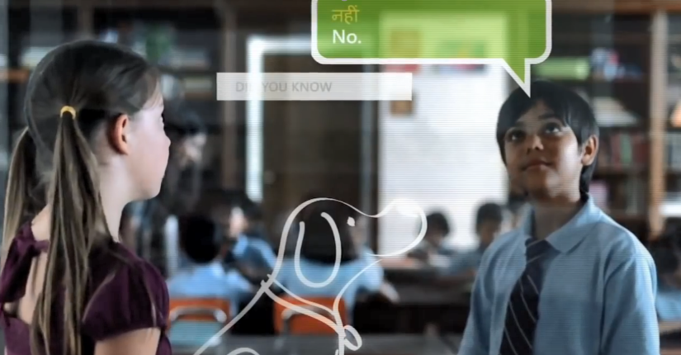
Video: https://www.youtube.com/watch?v=ozLaklIFWUI

Slide 4
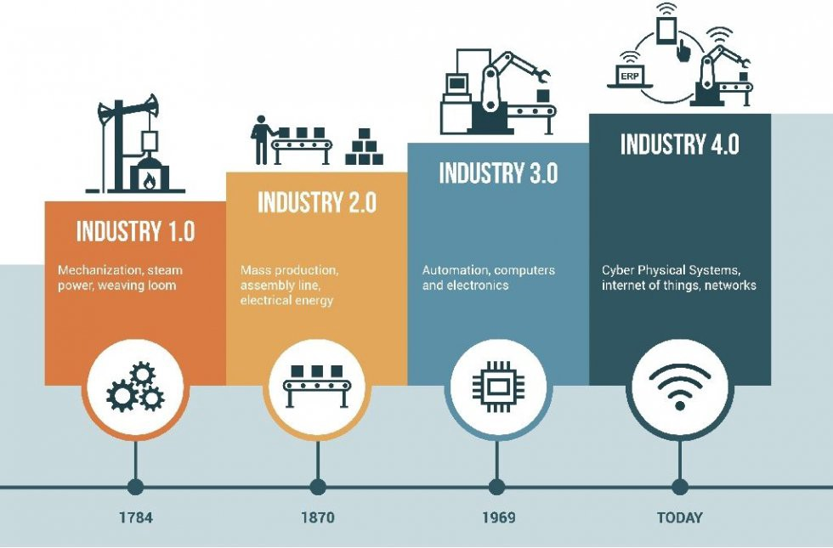
Revolusi Industri 4.0

Slide 5
Prinsip Industri 4.0
Interoperability
Information transparency
Technical assistance
Decentralized decision-making

Slide 6

Notes:
Making Indonesia 4.0, yang diluncurkan oleh Presiden Joko Widodo pada 4 April 2018

Slide 7
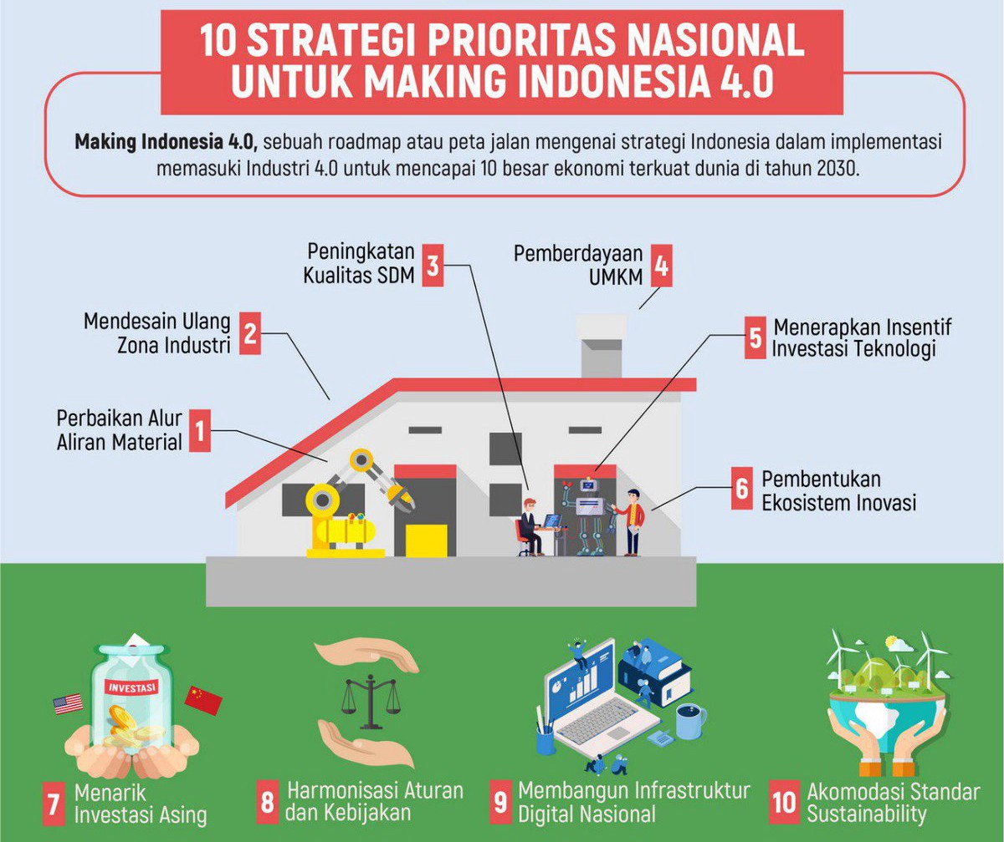

Slide 8
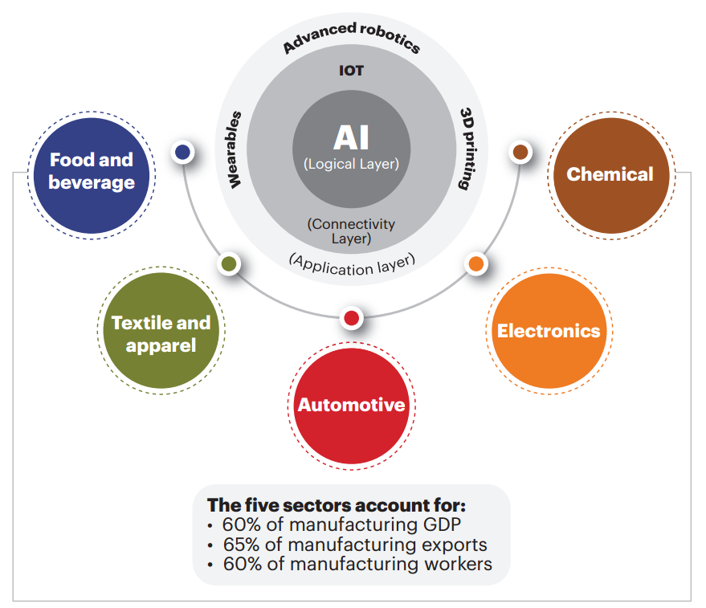
5 Sektor Prioritas

Slide 9
computer vision ?
Computer vision is an interdisciplinary field that deals with how computers can be made to gain high-level understanding from digital images or videos. From the perspective of engineering, it seeks to automate tasks that the human visual system can do.
Notes:
Sumber: https://en.wikipedia.org/wiki/Computer_vision

Slide 10
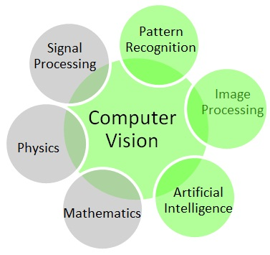
Computer vision melibatkan banyak disiplin ilmu

Slide 11
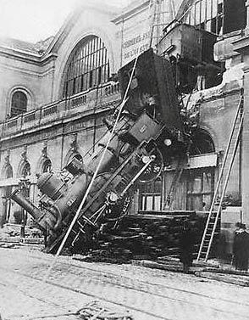
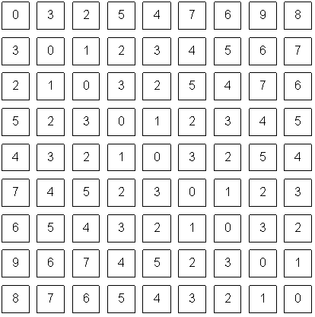
Tujuan utama computer vision : mengekstrak “makna” dari piksel-piksel
Apa yang kita lihat
Apa yang komputer lihat
Notes:
Gare Montparnasse, 1895

Slide 12

Tujuan utama computer vision : mengekstrak “makna” dari piksel-piksel
Notes:
Source: “80 million tiny images” by Torralba et al.

Slide 13
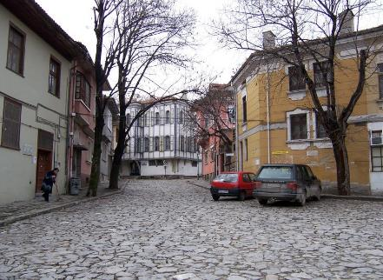
Informasi apa saja yang dapat diekstraksi dari sebuah gambar?
roof
tree
tree
sky
chimney
building
building
window
door
trashcan
car
car
person
Outdoor scene
ground
City
European
…
Semantic information
Geometric information
Notes:
My research area is computer vision. At a high level, the main goal of computer vision is to develop algorithms for extracting useful information from images. The main focus of my research is on recognition or image understanding, where the goal is to extract semantic information about the image – understanding the scene type and identifying the objects, just as a person would. The second major type of information computer vision techniques can extract is geometric information. [Describe recovering 3D scene information from multiple images.] Both of these research areas will be featured in my talk.

Slide 14
Mengapa belajar computer vision?
Vision is useful
Vision is interesting
Vision is difficult
Half of primate cerebral cortex is devoted to visual processing
Achieving human-level image understanding is probably “AI-complete”

Slide 15
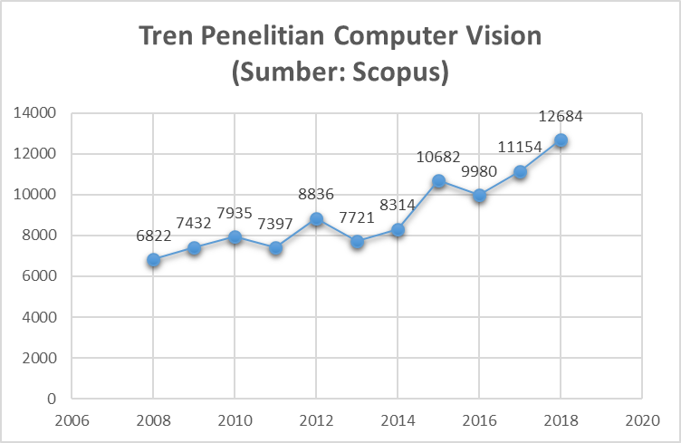
Penelitian di Bidang Computer Vision

Slide 16






Aplikasi Computer Vision
otomotif
kesehatan
retail
pertanian
perbankan
industri
Notes:
https://emerj.com/ai-sector-overviews/computer-vision-applications-shopping-driving-and-more/

Slide 17

Amazon Go

Slide 18

Video : https://www.youtube.com/watch?v=uoKsY9HDk6o&t=6s

Slide 19
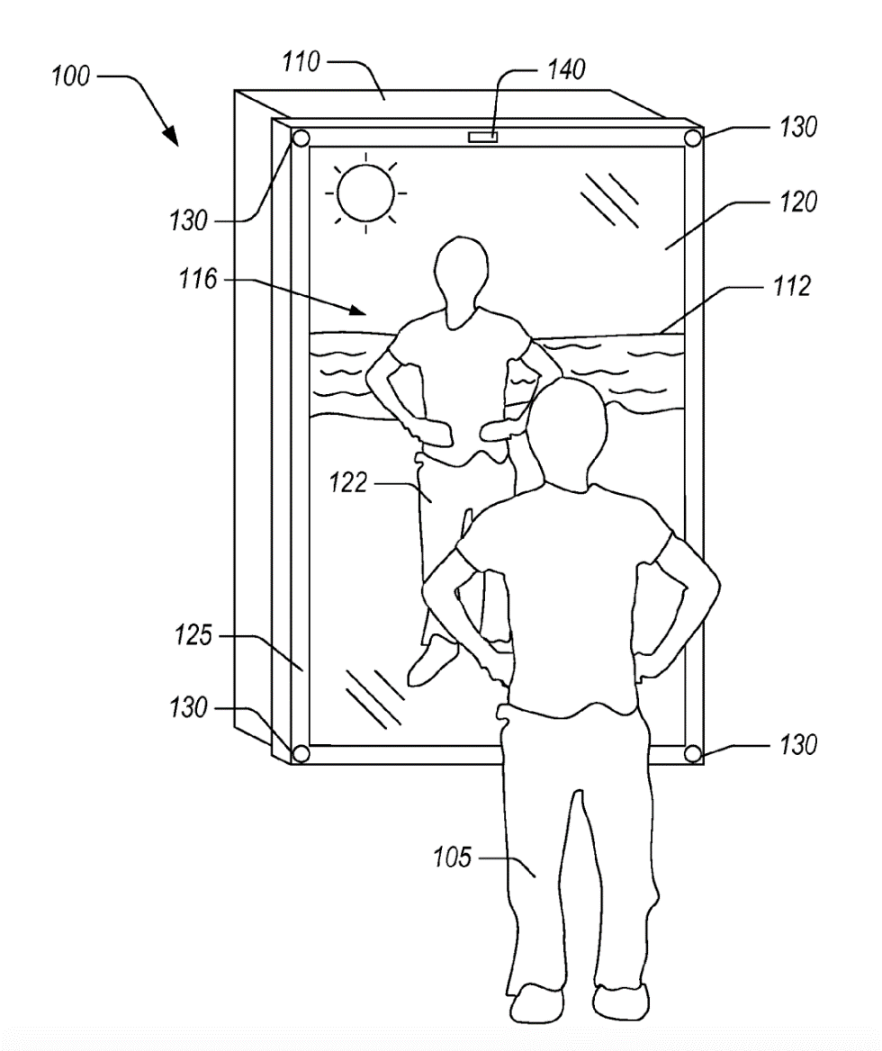
virtual mirror technology

Slide 20
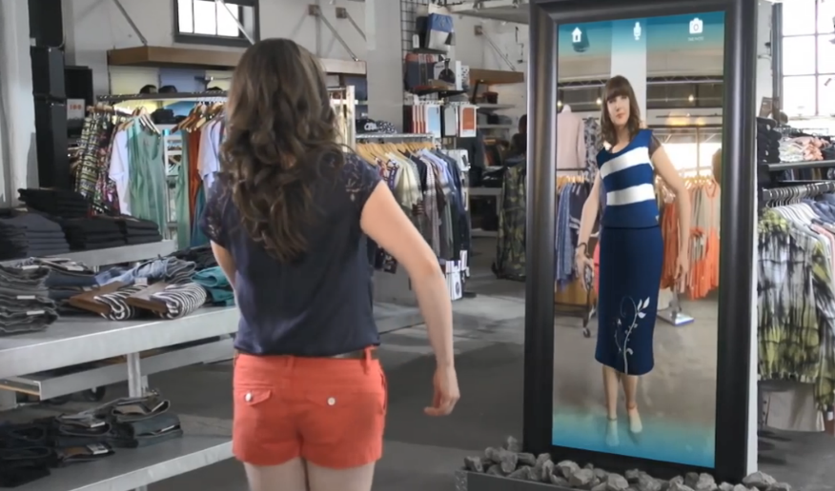
Video: https://www.youtube.com/watch?v=Mr71jrkzWq8

Slide 21

Self-Driving Car Project

Slide 22
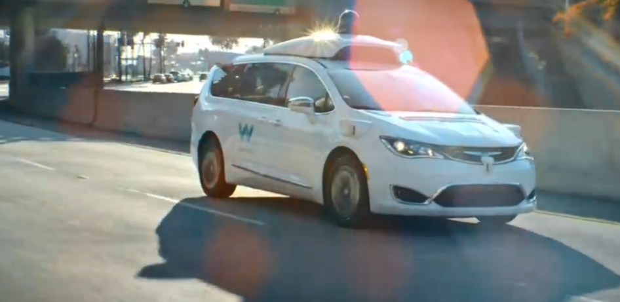
Video: https://www.youtube.com/watch?v=3XB-ygEJ93A

Slide 23
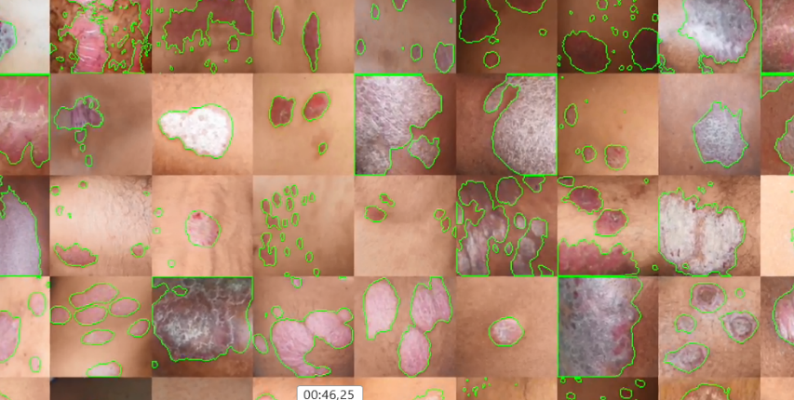
DermLens: recognize psoriasis
Video: https://youtu.be/8UQN8quZXKs

Slide 24
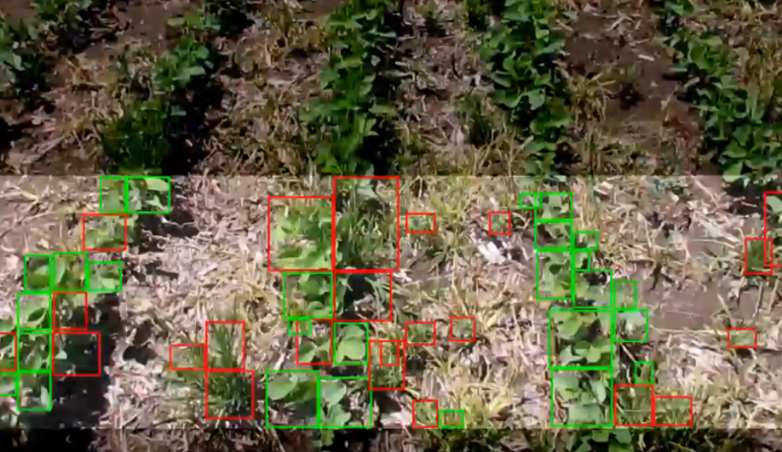
Deteksi rumput
Video: https://www.youtube.com/watch?v=2kSl1QOt96k

Slide 25
Dan masih banyak contoh lainnya….
Automated traffic law enforcement
Intelligent Traffic Lights System
Face recognition
Pedestrian detection
Object detection
Facial expression
….
Notes:
Demo: PedestrianTrackingFromMovingCameraExample

Slide 26
Tantangan di bidang computer vision

Slide 27
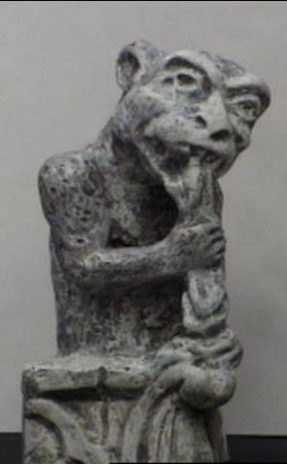
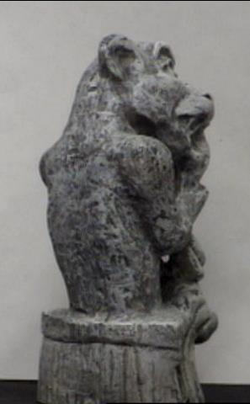
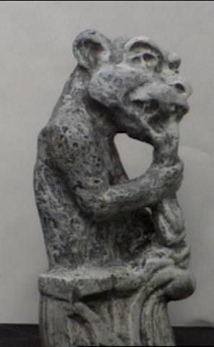
Challenges: viewpoint variation

Slide 28
Challenges: illumination

Slide 29
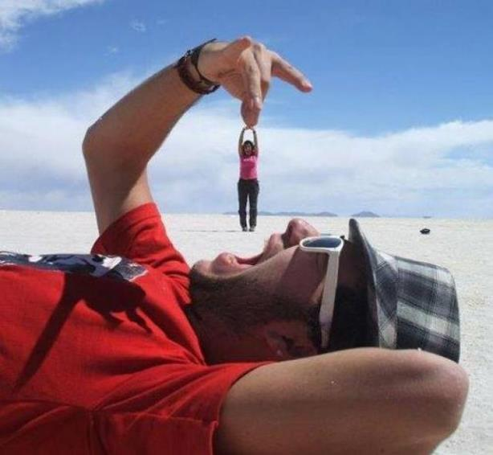
Challenges: scale

Slide 30
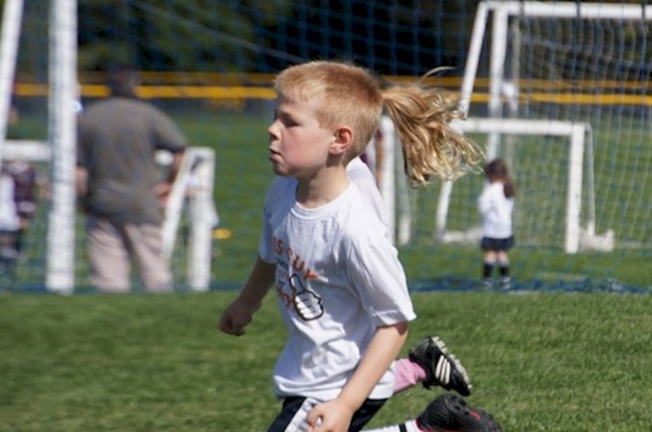
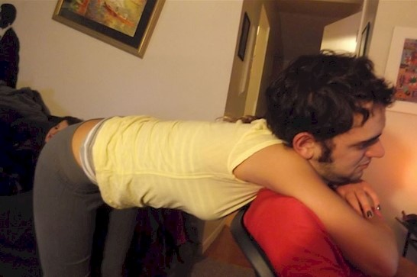
Challenges: deformation

Slide 31
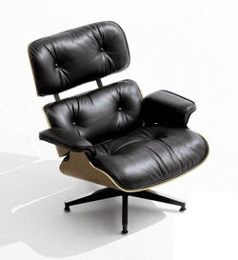
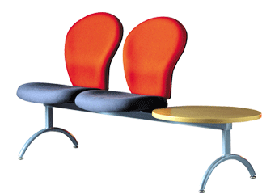
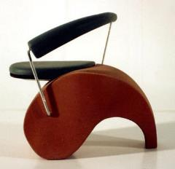
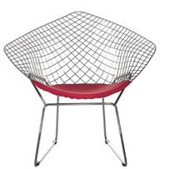
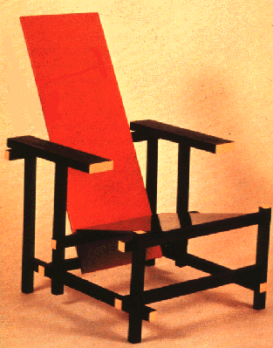
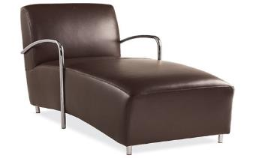
Challenges: object intra-class variation
Notes:
slide credit: Fei-Fei, Fergus & Torralba

Slide 32
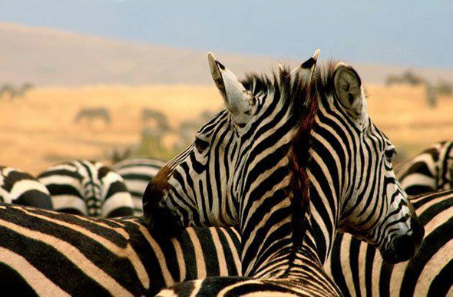
Challenges: occlusion, clutter
Image source: National Geographic

Slide 33
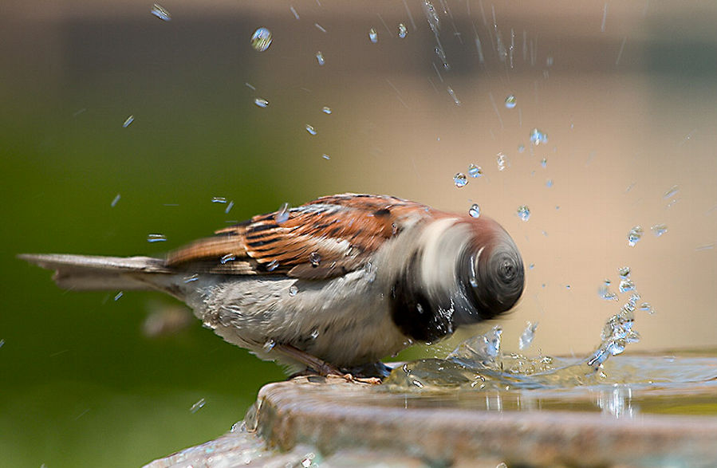
Challenges: Motion

Slide 34


Challenges: ambiguity
slide credit: Fei-Fei, Fergus & Torralba

Slide 35
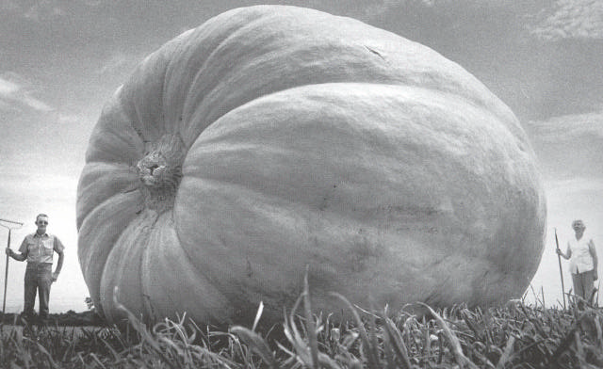

Challenges: ambiguity
Many different 3D scenes could have given rise to a particular 2D picture

Slide 36
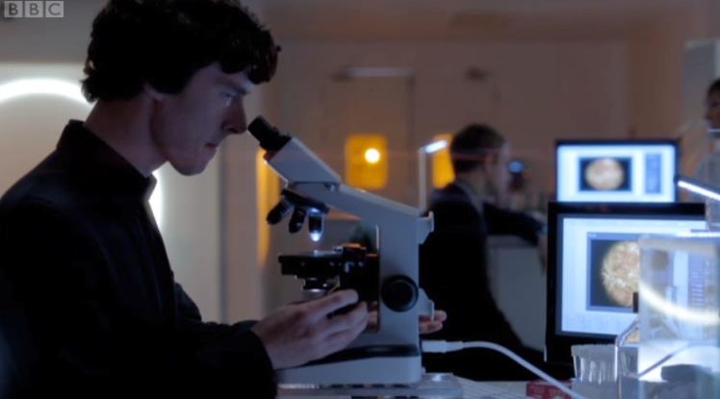
Challenges or opportunities?
Images are confusing, but they also reveal the structure of the world through numerous cues
Our job is to interpret the cues!

Slide 37
Bagaimana belajar computer vision ?

Slide 38

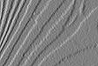
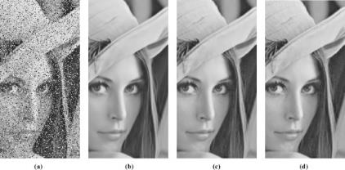
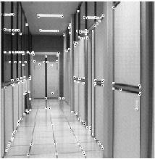
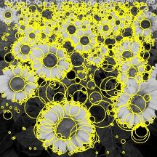
1. Pengolahan Citra Digital
*
=
Linear filtering Edge detection
Cameras and sensors Light and color
Image enhancement
Feature extraction, feature tracking

Slide 39
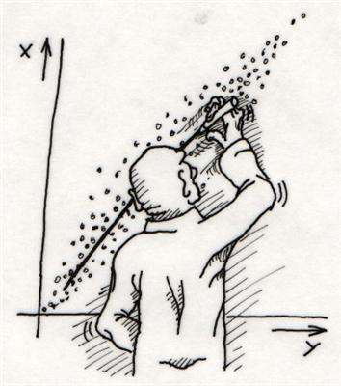
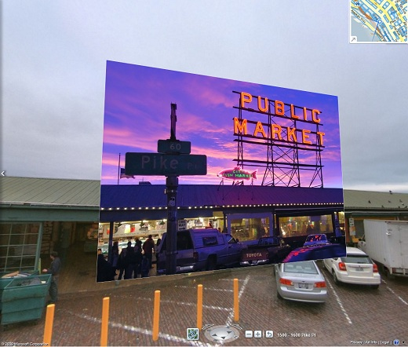
2. Fitting and Grouping
Fitting: Least squares Hough transform RANSAC
Alignment

Slide 40
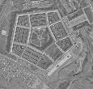
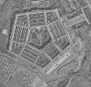
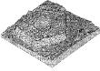
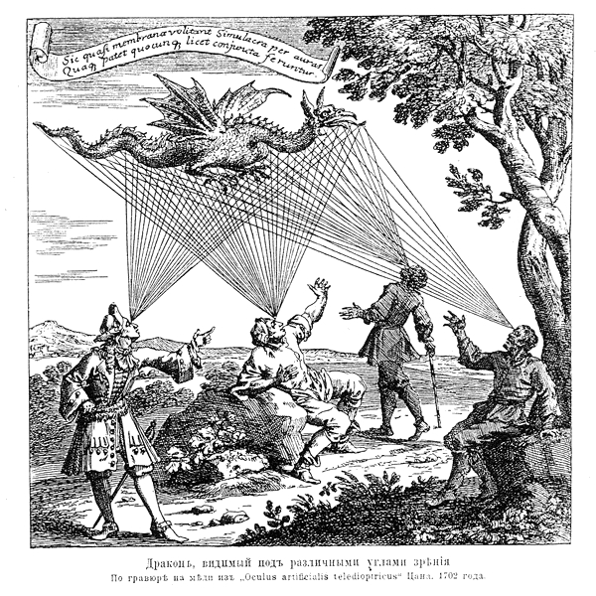
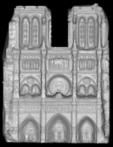
3. Multi-view Geometry
Epipolar geometry
Stereo
Structure from motion
3D Photography

Slide 41
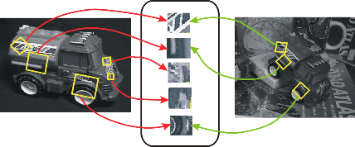
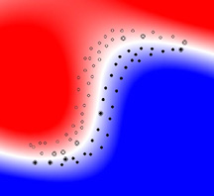
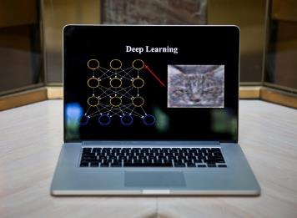
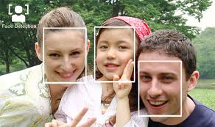
Recognition
Instance recognition, large-scale alignment
Image classification
Object detection
Deep learning
Notes:
Demo: PedestrianTrackingFromMovingCameraExample
Demo: medfilt2 - raisa

Slide 42
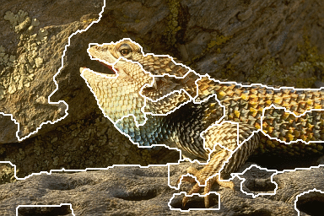
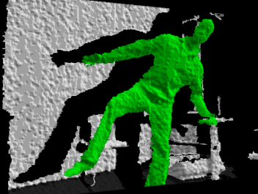
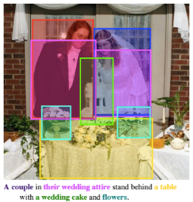
Terus belajar
Segmentation
Video
RGBD images
Images and text

Slide 43


Tools dan Pemrograman
Fungsi sangat lengkap
Powerfull
Standar industri
Komunitas dan referensi banyak
Diajarkan di banyak universitas
Berbayar
OpenCV (Open Source Computer Vision Library) is released under a BSD license and hence it’s free for both academic and commercial use. It has C++, Python and Java interfaces and supports Windows, Linux, Mac OS, iOS and Android. OpenCV was designed for computational efficiency and with a strong focus on real-time applications. Written in optimized C/C++, the library can take advantage of multi-core processing.

Slide 44

Tools dan Pemrograman
GNU Octave is a high-level language, primarily intended for numerical computations. It provides a convenient command line interface for solving linear and nonlinear problems numerically, and for performing other numerical experiments using a language that is mostly compatible with Matlab. It may also be used as a batch-oriented language.
GNU Octave is also freely redistributable software. You may redistribute it and/or modify it under the terms of the GNU General Public License (GPL) as published by the Free Software Foundation.

Slide 45

Tools dan Pemrograman
https://cloud.google.com/vision/
Google Cloud Vision API enables developers to perform image processing by encapsulating powerful machine learning models in a simple REST API that can be called in an application. Also, its Optical Character Recognition (OCR) functionality enables you to detect text in your images.

Slide 46
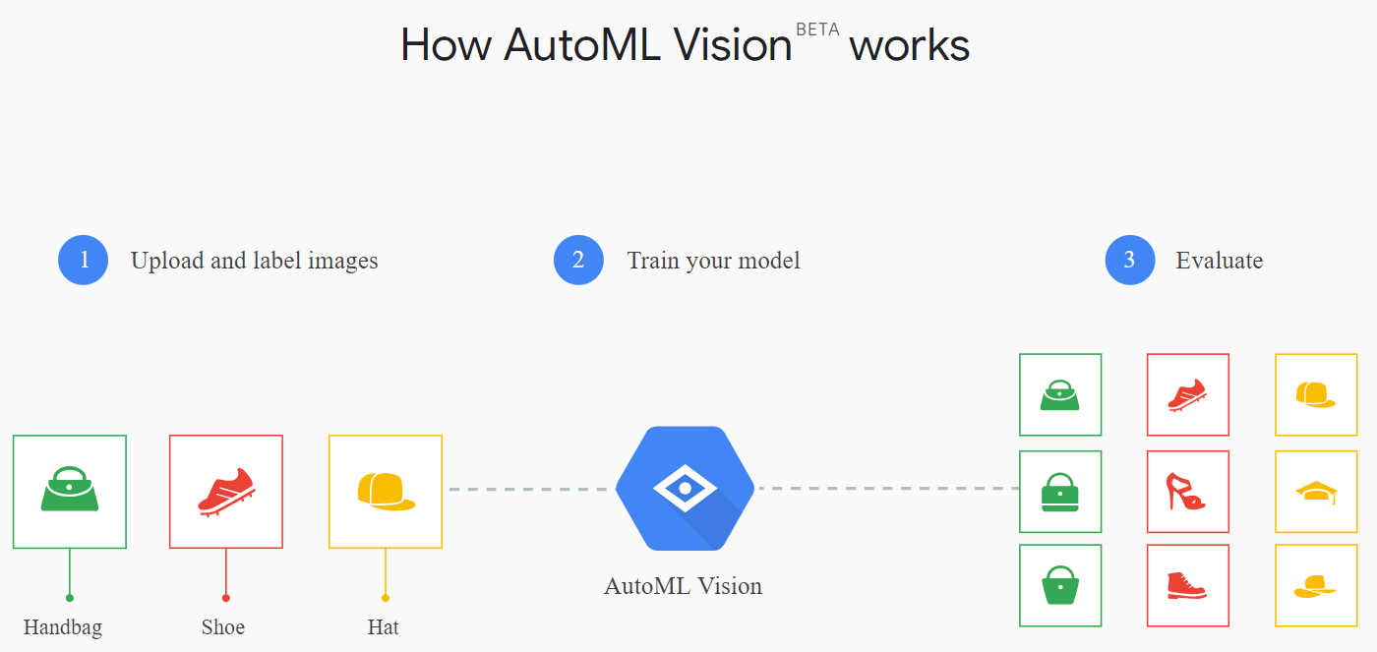
Tools dan Pemrograman

Slide 47

Tools dan Pemrograman
Amazon Rekognition makes it easy to add image and video analysis to your applications. You just provide an image or video to the Rekognition API, and the service can identify the objects, people, text, scenes, and activities, as well as detect any inappropriate content. Amazon Rekognition also provides highly accurate facial analysis and facial recognition on images and video that you provide. You can detect, analyze, and compare faces for a wide variety of user verification, people counting, and public safety use cases.
https://aws.amazon.com/rekognition/

Slide 48
Tools dan Pemrograman
Microsoft Azure Computer Vision API
https://azure.microsoft.com/en-in/services/cognitive-services/computer-vision/
Extract rich information from images to categorize and process visual data—and perform machine-assisted moderation of images to help curate your services.

Slide 49
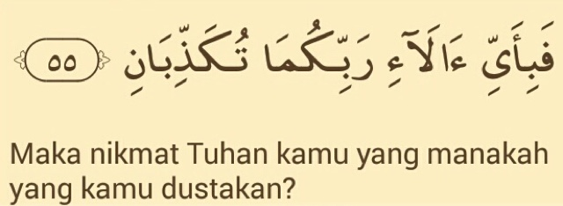
“Semakin banyak yang kita pelajari, semakin menunjukkan kebesaran, karunia dan kuasa Tuhan”

Slide 50
Referensi
Making Indonesia 4.0 - http://www.kemenperin.go.id/download/18384
Beberapa slide berdasarkan materi Computer Vision dari Universitas Illinois - http://slazebni.cs.illinois.edu/spring16
https://hub.packtpub.com/top-10-computer-vision-tools/
https://en.wikipedia.org/wiki/Computer_vision
Beberapa gambar diambil melalui situs pencari Google.

Slide 51
Terima Kasih
@achmatim
Achmad Solichin
achmatim@gmail.com
slideshare.net/achmatim
http://achmatim.net

